Slide 1
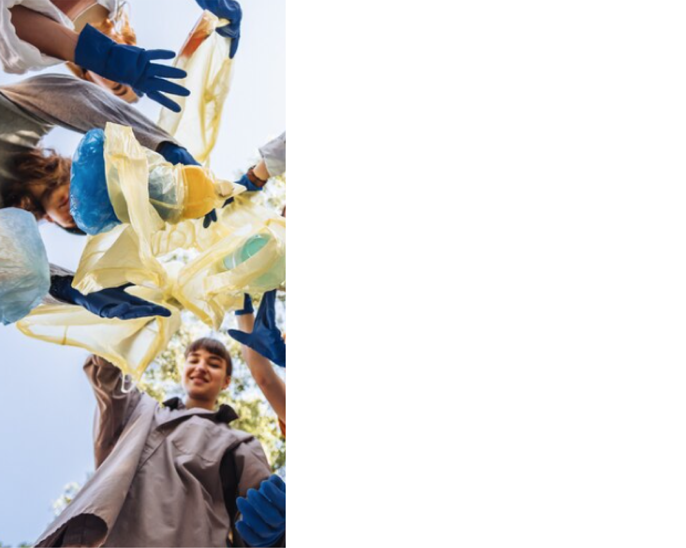





LIFE-IP CYzero WASTE: Intelligent monitoring and efficient waste reduction in Cyprus Island
LIFE20 IPE/CY/000011
Joanna Constantinidou, Department of Environment
10th International Conference on Sustainable Solid Waste Management
21-24 June 2023, Chania, Crete Island, Greece

Slide 2

LIFE IP CYzero WASTE PROJECT AT A GLANCE
The project runs 8 years from 01/10/2021 until 30/09/2029
Budget €14.785.848 (EU co-funding 60%)
Complementary Funding of €66mil. from Structural Funds 2021-2027 & Recovery and Resilience Fund 2021-2026.
Partners:
  Coordinating Beneficiary: Department of Environment (DoE)
  Associated Beneficiaries: National Technical University of Athens (NTUA), Agricultural Research Institute, Cyprus Chamber of Commerce and Industry, 10 Municipalities, 5 Development Agencies
Actions:
  3 Preparatory Actions
  10 Concrete Actions
  4 Monitoring Actions of project's impact
  3 Communication & Dissemination Actions
  2 Project Management and monitoring actions of project progress

Slide 3
LIFE IP PROJECT OBJECTIVES
Development of waste pilot actions in local authorities to promote the practical implementation of waste prioritisation:
– Separate sorting at the source of biowaste, recyclable materials & hazardous household waste
– Preparation for repair and reuse
– Collection of marine litter and discarded fishing equipment, including fishing boat mooring lines
Development of secondary material standards to implement the circular economy.
Mobilisation of additional financial resources to support the effective implementation of the National Waste Management Plan 2022-2028 and the Waste revention Programme Plan 2022-2028.
Strengthening of the use of financial instruments to support the circular economy.
Implementation of specific waste management actions that will support and strengthen the implementation of waste prioritization and separate collection of waste streams, to ensure the diversion of waste from landfills.
Implementation of actions to prevent food & agricultural waste generation.
Introduction of institutional changes to create of a Waste Management Coordinating Body.
Raising of awareness among stakeholders and the general public about the concept of circular economy and its connection to the waste sector.
Dissemination of project results and support for their implementation and reproduction in other areas of the island.

Slide 4
LIFE IP PREPARATORY ACTIONS
A1. Assessment of the current situation, update studies at national level, mapping of stakeholders
A2. Preparatory technical and economic studies for demonstration projects.
A3. Study for the establishment of the Coordinating Body between the Central and Local Government.
LIFE IP CONCRETE ACTIONS
C1. Biowaste source separation and management schemes by installing of home and decentralised compost units in mountainous and remote areas in Cyprus.
C2. Installation and operation of 50 Green Kiosks for dry recyclables in mountainous & remote areas
C3. Implementation of Household Hazardous Waste (HHW) collection and management either by towed mobile units that will tour different areas, or by HHW management centers.
C4. Foodwaste and agrowaste prevention actions on creating an effective system to monitor and prevent food waste generation along the entire food supply chain from production to consumption
C5. Construction and operation of 2 reuse and repair centres and second-hand store network.
C6. Monitoring and optimising of the “Pay As You Throw” Scheme
C7. Marine debris collection and management system
C8. Application of economic instruments
C9. Capacity building activities
C10. Establishment of the Waste Management Coordinating Body

Slide 5
LIFE IP MONITORING ACTIONS
D1. Key Performance indicators.
D2. Monitoring of Circular Economy Indicators at national scale and for key economic sectors and value chains.
D3. Monitoring the project environmental impact.
D4. Monitoring the project socio-economic impact.
LIFE IP COMMUNICATION ACTIONS
E1. Public awareness, involvement and dissemination.
E2. EU-level and international dissemination and networking.
E3. Project replication and transfer strategy and implementation .
LIFE IP PROJECT MANAGEMENT ACTIONS
F1. Overall project management, monitoring and reporting to the EC.
F2. Complementary Funding Monitoring and Mobilisation.

Slide 6
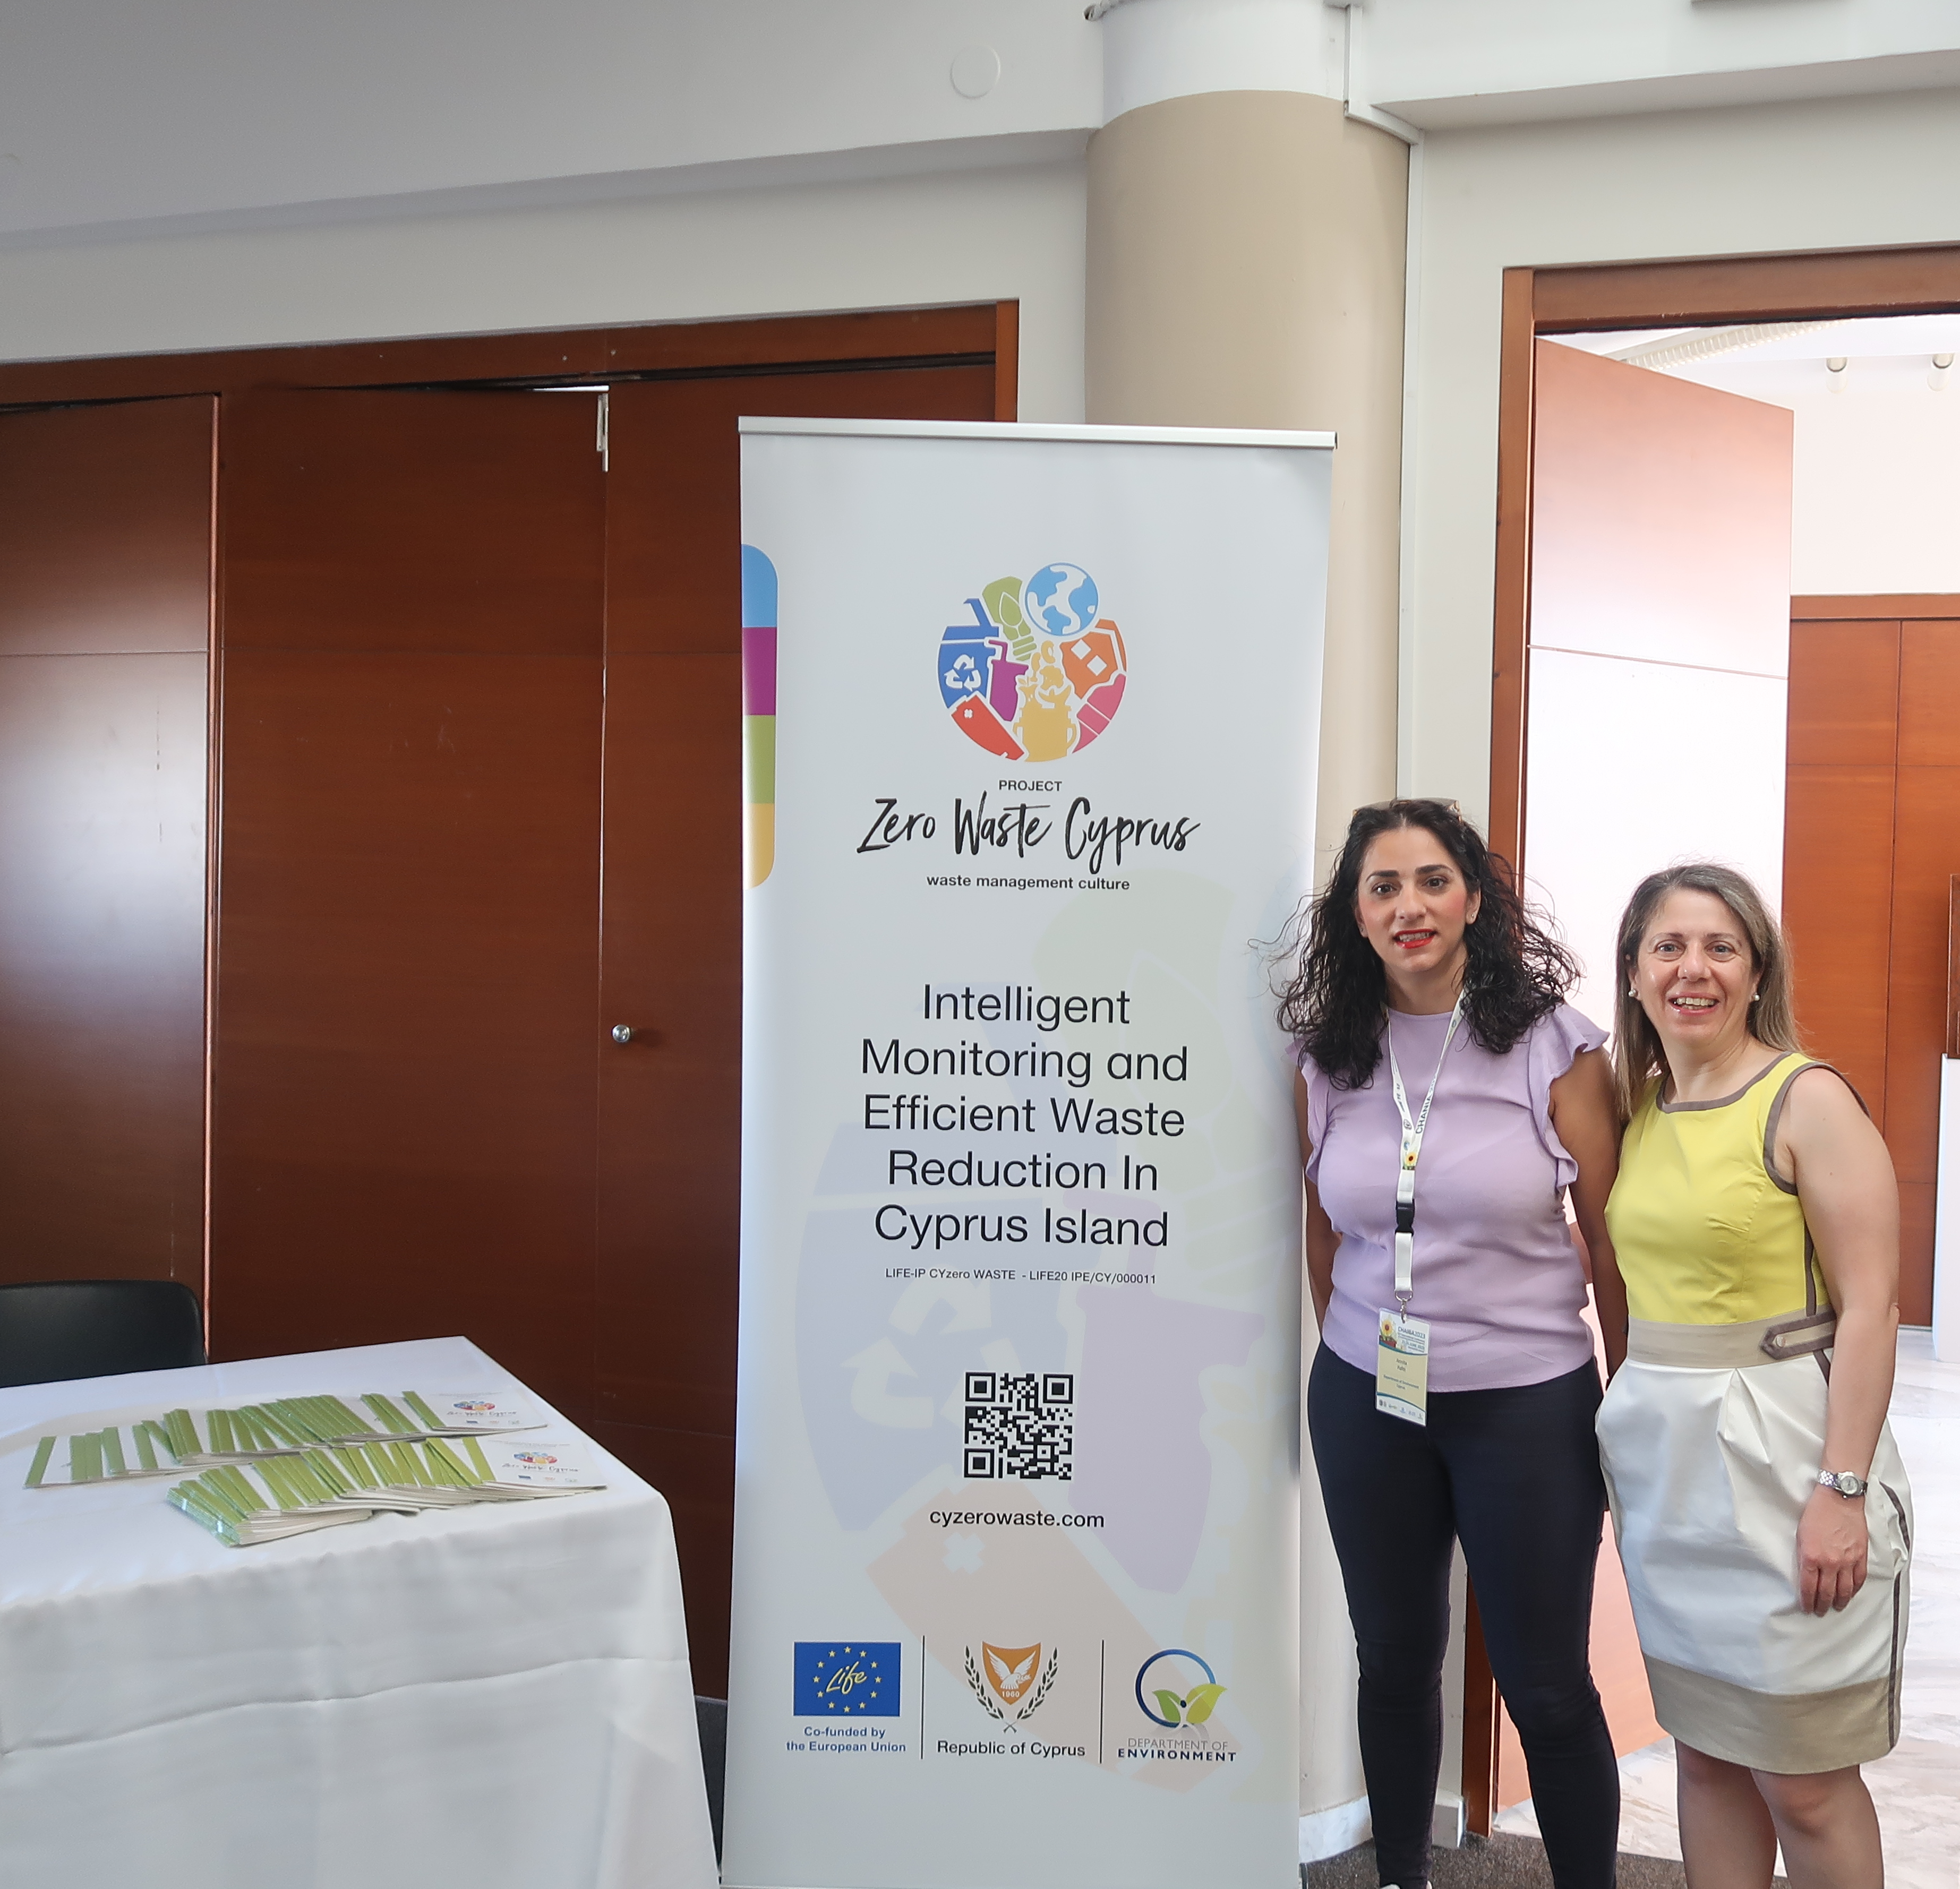
ACTION E2: EU-level and international dissemination and networking [1]
Action focuses on disseminating the project outcome and respectful added value for the EU Community to the public of the EU MS.
E.2.1. Strong networking based on the existing EU-level network of the project partners in terms of local community and competent authorities forms the basis for disseminating the project outcome to consortia of particular added value.
E.2.2. EU and International Thematic workshops shall be attended by project partners, along with the production of the communication material.

Slide 7
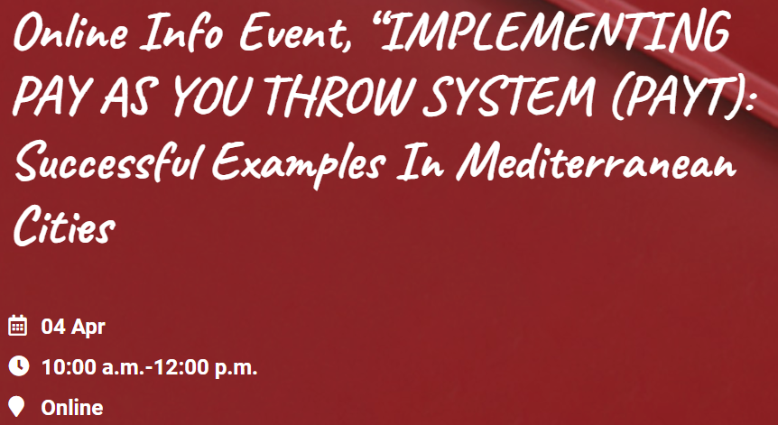

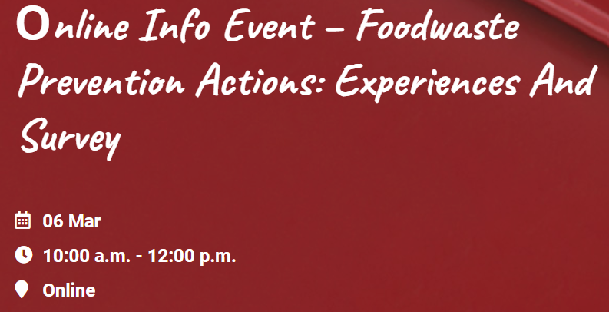

ACTION E2: EU-level and international dissemination and networking [2]

Slide 8


Thank you
Ευχαριστώ
Department of Environment
Ministry of Agriculture, Rural Development and Environment
Joanna Constantinidou
Senior Environment Officer jconstantinidou@environment.moa.gov.cy
cyzerowaste.com

